Slide 1
Brain Tumor Segmentation using U-Net and Attention U-Net
By:
Maniteja Bonagani

Slide 2
Introduction
Brain tumor segmentation is a crucial task in medical imaging analysis, aiding in diagnosis, treatment planning, and monitoring.
Challenges: Irregular tumor shapes, varying intensities, ill-defined boundaries, heterogeneity, imaging artifacts, and noise.
Motivation: Deep learning models, particularly convolutional neural networks (CNNs), have demonstrated remarkable success in medical image analysis, capturing complex patterns and subtle features.

Slide 3
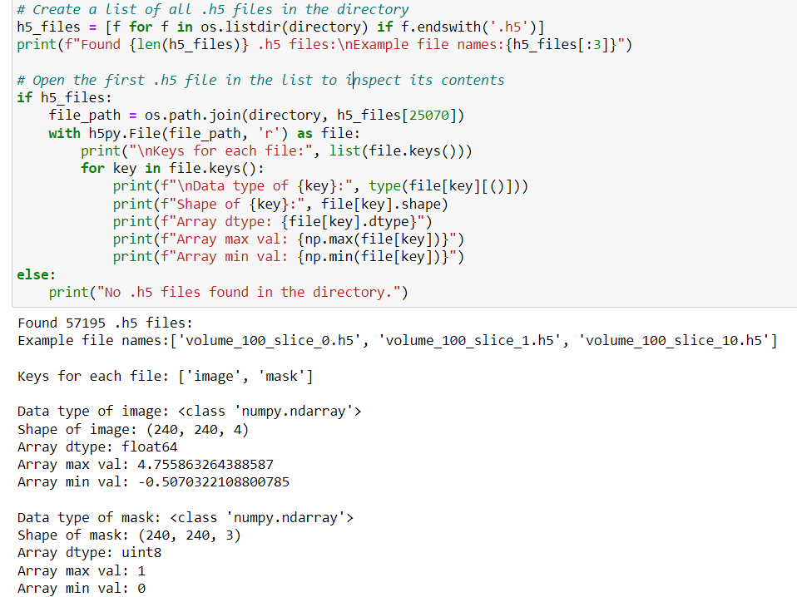
Dataset
BraTS2020 dataset: Contains brain MRI scans and corresponding segmentation masks.
Data format: .h5 files containing 4 image channels (T1, T1c, T2, FLAIR) and 3 mask channels (necrotic, edema, tumor).

Slide 4
Data Preprocessing
The BrainScanDataset class is a custom dataset handler that extends PyTorch's Dataset class. It is designed to manage the loading and preprocessing of MRI scan data stored in .h5 files for brain tumor segmentation tasks.
The constructor (__init__) takes a list of file paths pointing to the .h5 files and an optional deterministic flag. If deterministic is set to True, the random seed is fixed to ensure reproducibility, particularly useful when generating test images.
The __len__ method returns the total number of .h5 files in the dataset, allowing PyTorch's DataLoader to iterate over the dataset.
The __getitem__ method is responsible for loading individual .h5 files by index, extracting the image and mask data, and performing necessary preprocessing steps such as reshaping and normalization.
The image and mask data are reshaped from (Height, Width, Channels) to (Channels, Height, Width) to match the input format expected by CNNs in PyTorch.
Pixel values for each channel in the image are normalized to be between 0 and 1, enhancing model training stability and performance.
The dataset is split into training and validation sets, typically in a 90:10 ratio, to evaluate the model's performance on unseen data.

Slide 5
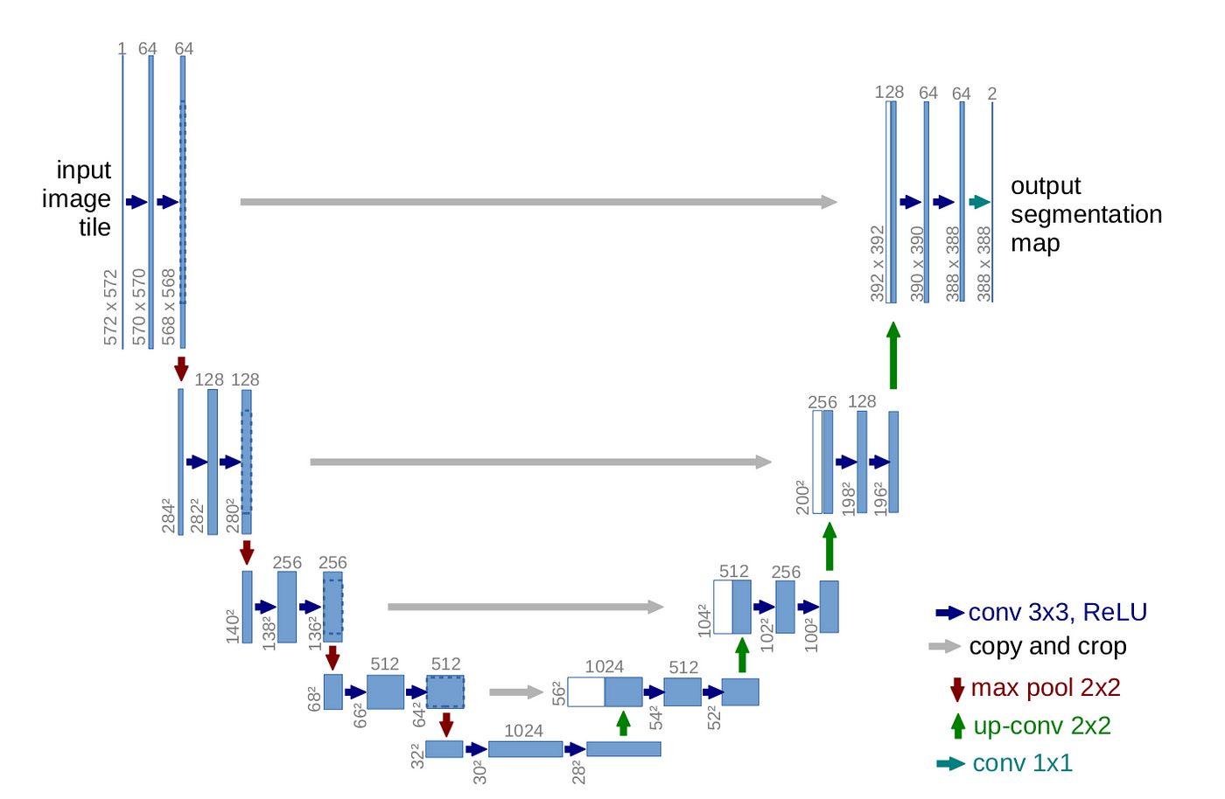
U-Net Architecture
The U-Net architecture is a popular CNN for biomedical image segmentation, featuring an encoder-decoder structure with skip connections.
The EncoderBlock consists of two convolutional layers with a ReLU activation function in between. It captures features at different scales and increases the model's receptive field.
The DecoderBlock also contains convolutional layers and is responsible for upsampling the feature maps to reconstruct the segmentation mask at the original resolution.
The UNet class combines these blocks, using downsampling (max pooling) in the encoder path and upsampling (transposed convolutions or bilinear upsampling) in the decoder path.
Skip connections are used to concatenate feature maps from the encoder to the decoder, preserving spatial information lost during downsampling.

Slide 6
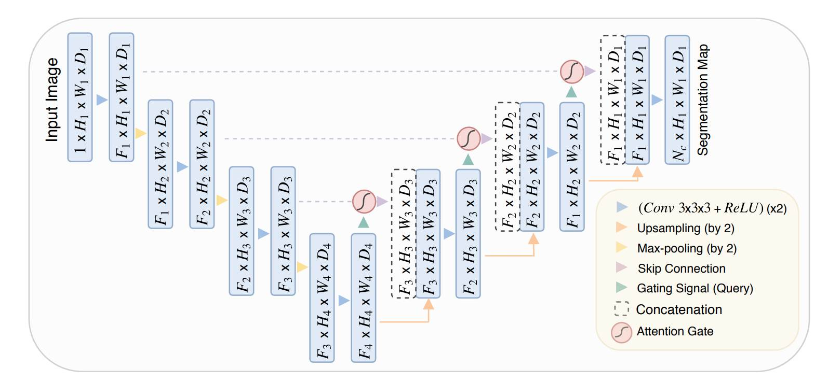
Attention U-Net Architecture
The Attention U-Net architecture enhances the standard U-Net by incorporating attention mechanisms, which help the model focus on relevant features for segmentation.
The AttentionResBlock is a key component that computes attention maps to weigh the feature maps from the encoder before passing them to the decoder.
The attention mechanism involves query and key convolutions followed by an activation function and a sigmoid function to generate the attention map.
The AttentionUNet class integrates the attention blocks with the encoder and decoder blocks, applying the attention maps to the skip connections.
This architecture is particularly effective for brain tumor segmentation, where it is crucial to focus on specific tumor regions while ignoring irrelevant areas.

Slide 7
Training Loop
The training process involves:
Setting up the model and training configuration.
Initializing the model and moving it to the chosen device.
Adam optimizer for parameter updates and binary cross-entropy loss as the loss function.
Iterate through each epoch, and can optionally dynamically adjust the learning rate.
For each epoch, conduct both training and validation steps:
In the training step, feed batches of data to the model, computes the loss, and updates the model parameters.
In the validation step, evaluate the model on a separate dataset to monitor performance without updating model parameters.
Track and print out the average training and validation losses for each epoch, providing insights into the model's learning progress.
Finally, the function returns lists of training and validation losses for further analysis or plotting.

Slide 8
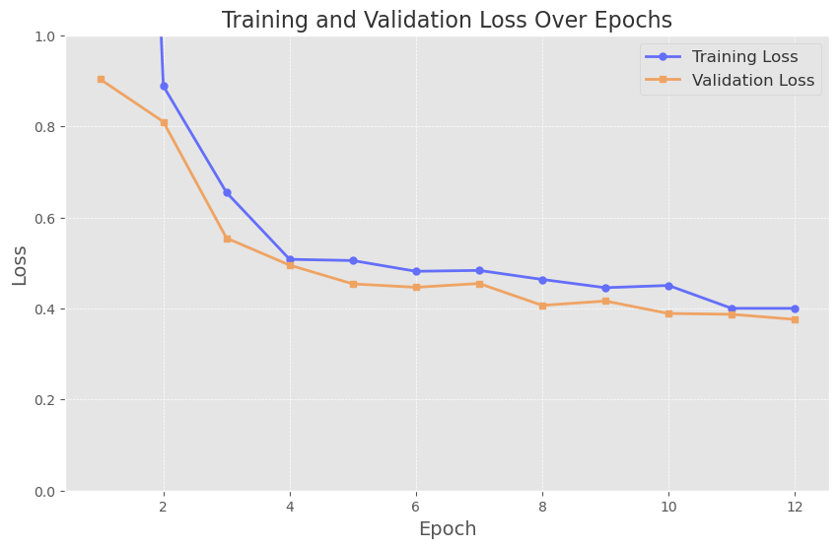
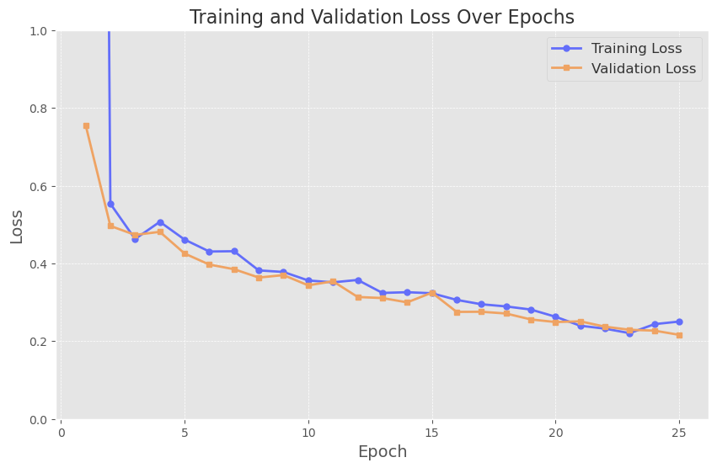
Visualizing Training Curves
U-Net
Attention U-Net

Slide 9
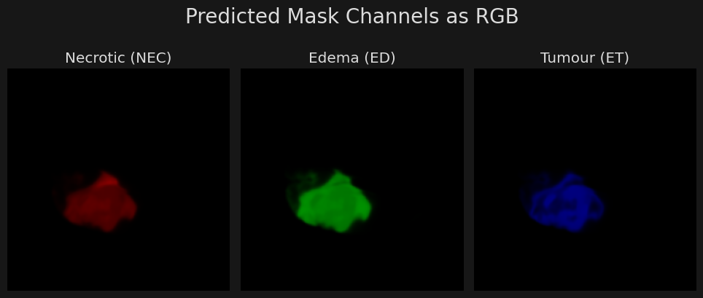
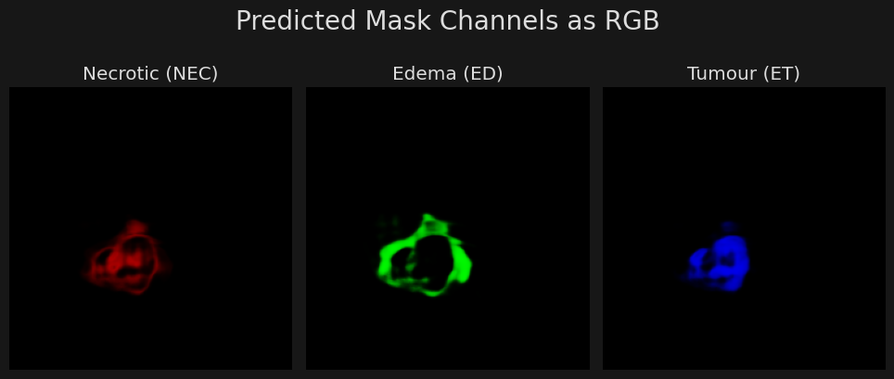
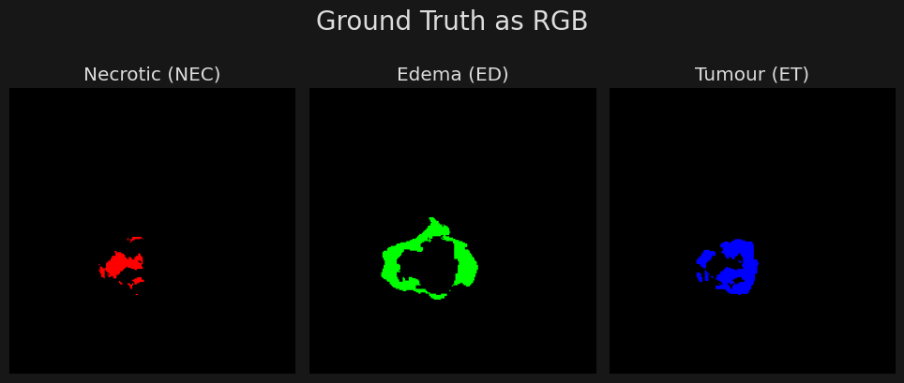
Model Evaluation
U-Net
Attention U-Net

Slide 10
Conclusion
The Attention U-Net outperformed the U-Net in terms of both training and validation losses, indicating its superior ability to generalize and segment complex tumor regions.
However, the Attention U-Net architecture is more computationally expensive due to the additional attention mechanisms, which impact training time and inference speed.
Potential improvements could include exploring more advanced attention mechanisms, ensemble models, or transfer learning techniques to further enhance the segmentation accuracy and efficiency.

Slide 11
THANK YOU

